Slide 1

HIGHCLOUD AIRLINES
GROUP 4

Slide 2
Our Team
1 Kajal Bile
2 Shambhavi Joshi
3 Hari
4 Sharon Dass
5 Drashti

Slide 3
INDEX
Introduction
Objective
Business Overview
Project scope
Data model challenges
Dashboard Overview
Recomendations & Conclusion

Slide 4
INTRODUCTION
“To revolutionize the airline industry through data-driven insights and optimization” High Cloud Airline, a leading player in the aviation sector, has been at the forefront of providing seamless air travel experiences. Established with a commitment to excellence, High Cloud has consistently set industry standards in terms of reliability, safety, and customer satisfaction. Extensive network of routes spans across regions, connecting people and cultures, making High Cloud a preferred choice for millions of travellers globally. High Cloud embraces innovation and modern technology to enhance operational efficiency and stay at the forefront of the aviation landscape .

Slide 5
Objective
To gain a comprehensive understanding of “High Cloud Airlines” operations through data analysis. This will involve investigating load factors, identifying top carrier names based on passenger preference, analyzing popular routes, and exploring other key metrics. The ultimate goal is to provide actionable recommendations that can enhance operational efficiency and Profitability .

Slide 6
Business OVERVIEW
In today’s competitive airline industry, data analysis plays a critical role in optimizing operations and maximizing profitability. By harnessing the power of data, High Cloud Airlines can gain valuable insights into various aspects of its business, allowing them to make data-driven decisions that can lead to ;
Improved load factor
Enhance Passenger Experience
Optimized resource allocation
Data –Driven Decision Making

Slide 7
SCOPE OF PROJECT
The Project aimed to leverage the power of data analysis and extract valuable insights to optimize high cloud airline operations and performance. The specific scope of the project focused on analyzing key performance indicators (KPIs) to gain deeper understanding of:
Load Factor
Passenger Preferences
Popular Routes
Operational Efficiency

Slide 8
DATA MODEL CHALLENGES
Throughout our analysis, we encountered various challenges in handling the data. Overcoming these challenges is crucial for accurate insights.
Data Volume: Managing and Processing large datasets efficiently.
Data Quality: Ensuring accuracy and reliability of the data.
Complex Relationships: Establishing connections between different data points.

Slide 9
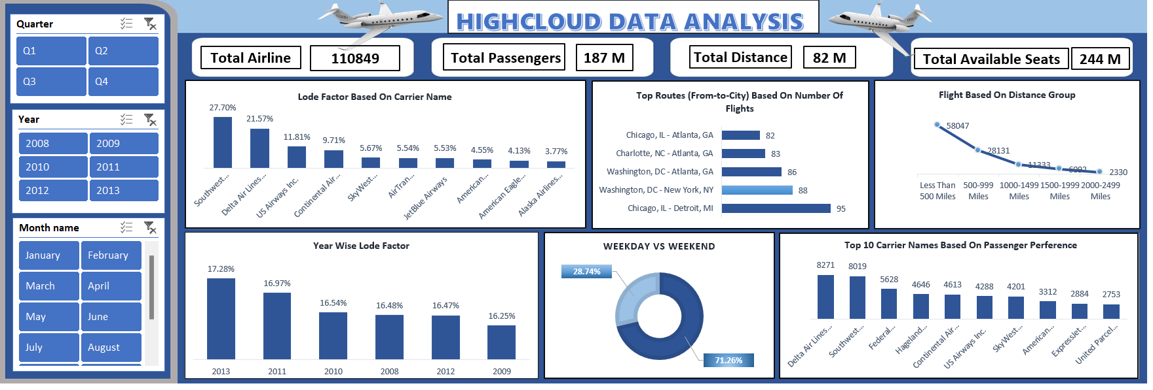
EXCEL DASHBOARD

Slide 10
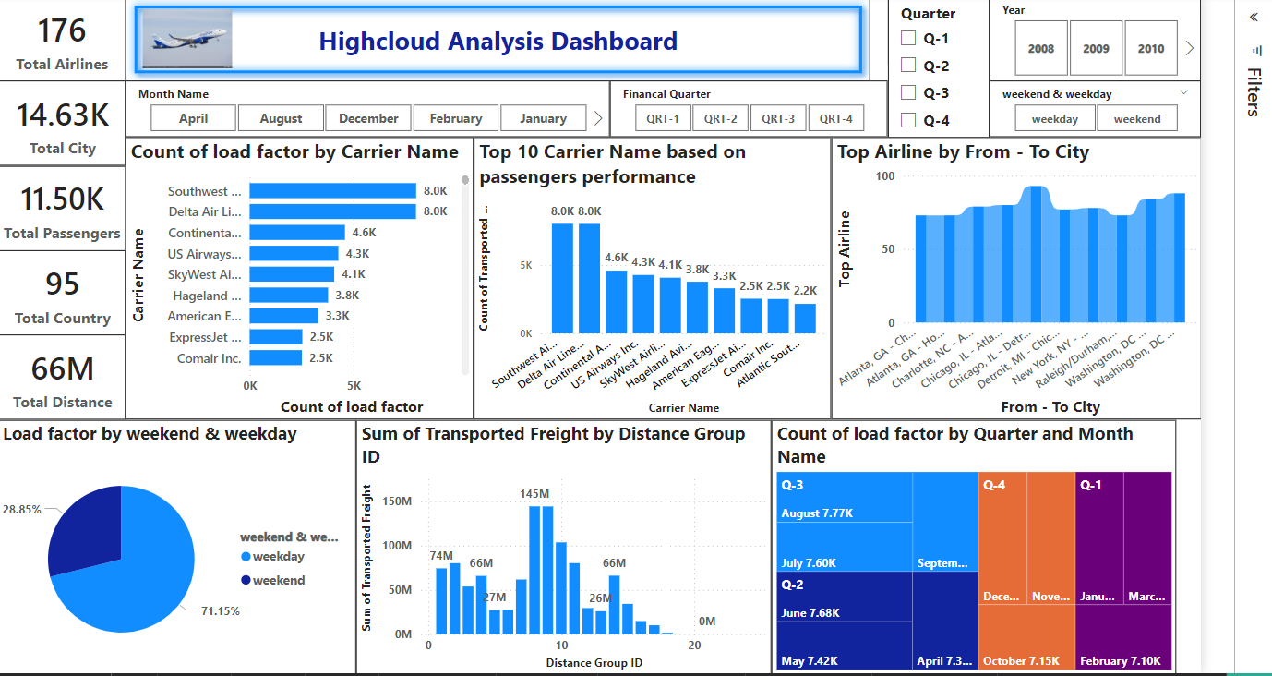
POWER BI DASHBOARD

Slide 11
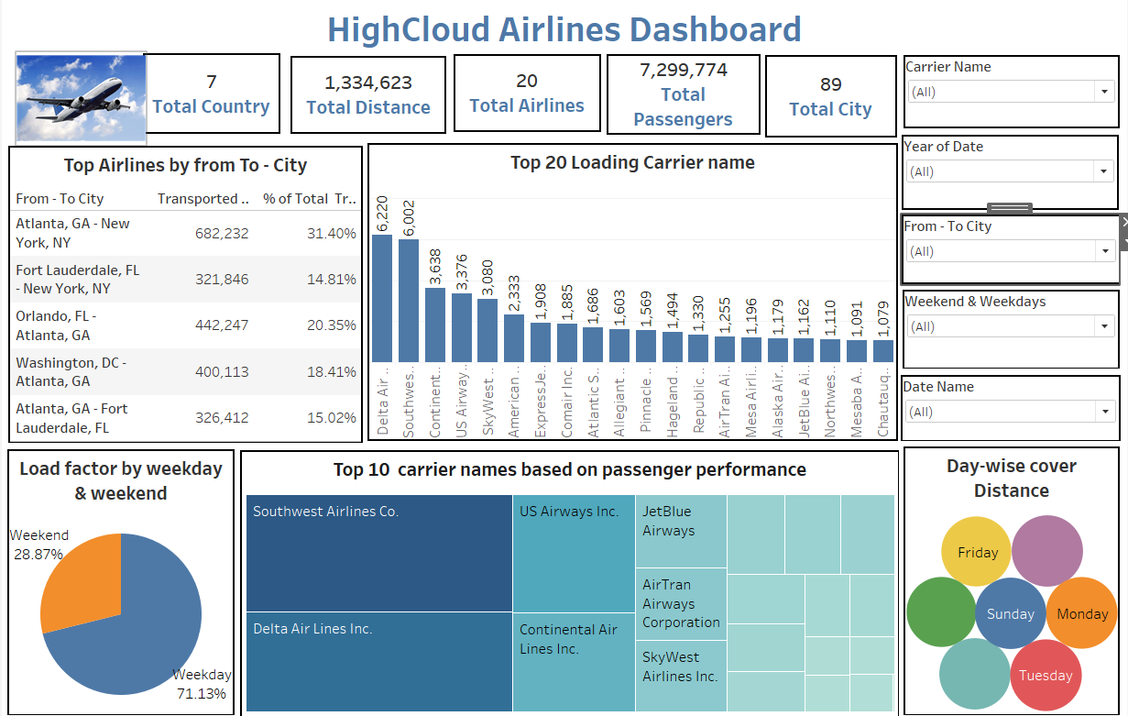
TABLEAU DASHBOARD

Slide 12
SQL QUERIES

Slide 13
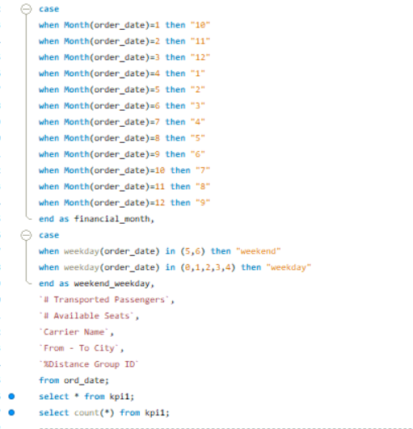
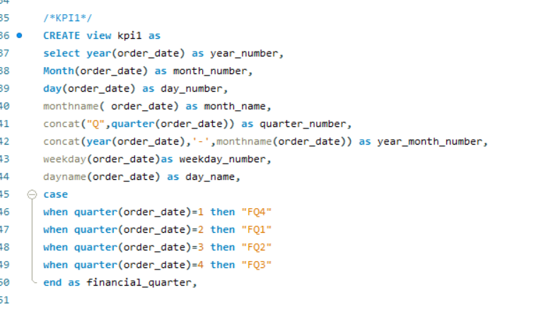
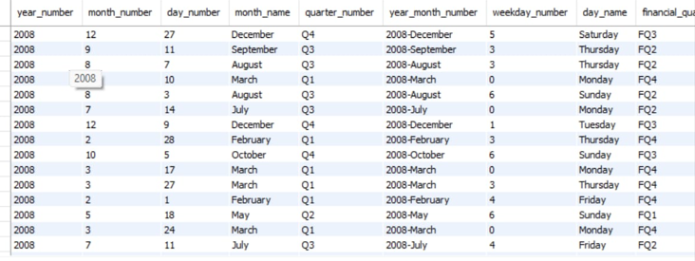

Slide 14
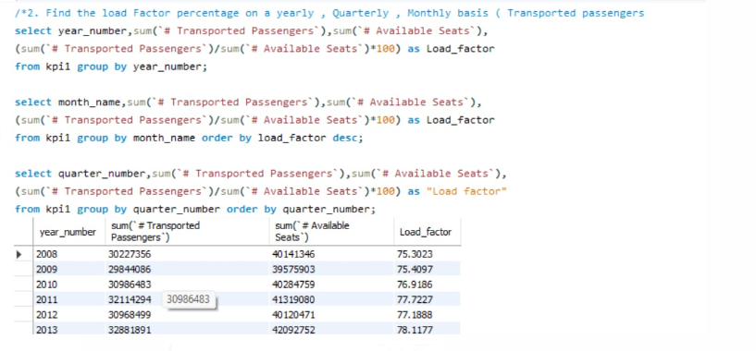
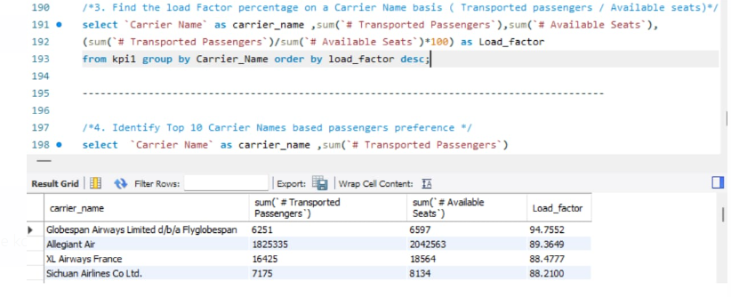

Slide 15
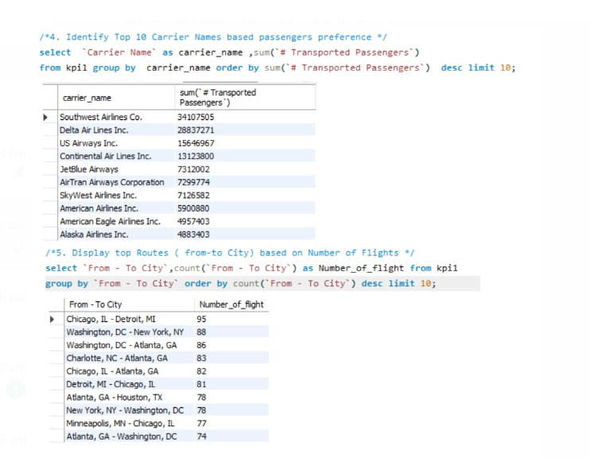

Slide 16
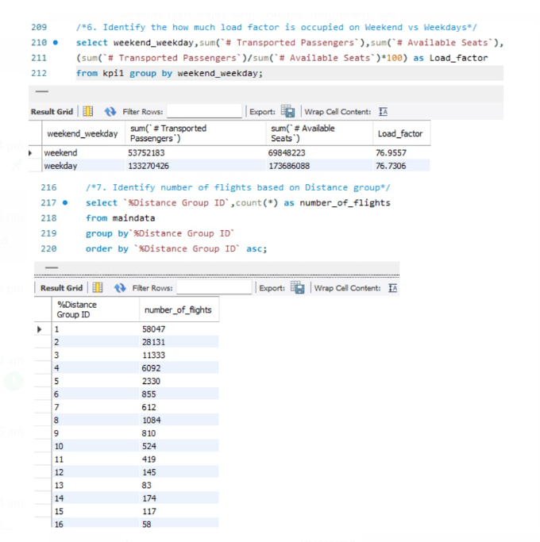

Slide 17
RECOMMENDATIONS
Optimize Fight Routes: Utilize insights from up routes and flights to Optimize schedule and resource allocation.
Enhance Load Factor: Leverage load factor analysis to identify trends and implement strategies for increased efficiency.
Strategic Carrier Partnership: Collaborate with top carriers to maximize passenger transportation and enhance overall performance.
Resource Allocation: Allocate resources strategically based on flight schedules and passenger volume data. This ensures efficient operation and minimizes wait times at airports with high passenger traffic .

Slide 18
Conclusion
High Cloud Airlines empowers the aviation industry with actionable insights, foresting efficiency, and strategic decision–making. The presented KPIs offer a glimpse into the vast potential for improvement and growth within the industry. By harnessing the power of data, we can drive positive changes, ensuring a bright future for High Cloud Airlines and its partners in the aviation sector .

Slide 19
Thank you!

